Slide 1
Philosophy of Data Recap
Maia, Ziwei, Ben

Slide 2
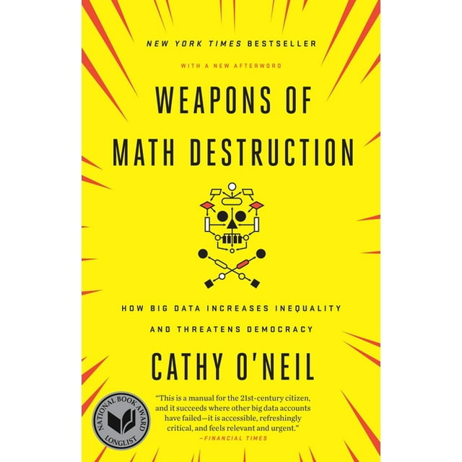

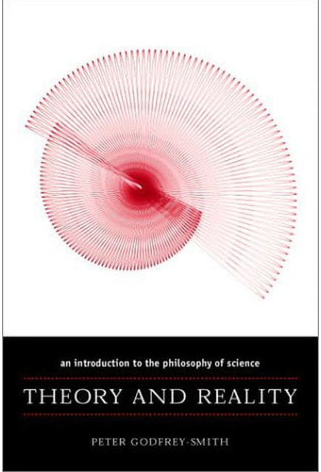
Textbooks

Slide 3
Basics of Arguments
Definition: a list of statements, one of which is the conclusion and the others are "premises"
Logic: the study of the strength of the evidence of an argument
Example:
Premise 1 - All flowers are plants.
Premise 2 - All daisies are flowers.
Conclusion - Therefore, all daisies are plants.
This a valid inductive argument – the conclusion is true if the premises are true!

Slide 4
Prediction and Generalization
Strong prediction: 100% of mornings start with a sunrise. Tomorrow morning will start with a sunrise.
Weak prediction: 80% of students have passed this class. The next student will pass this class.
Strong generalization: 100% of mornings have started with a sunrise. So, all mornings will start with a sunrise.
Weak generalization: 80% of students in this class have passed. All students will pass this class.

Slide 5

Connection to Data Analytics
This is the basis of what's called Goodman's Paradox, in which arguments are deemed "predictable" or "unpredictable"
Predicting the future with an algorithm inherently involves generalization!! -- we should acknowledge this
Everything in data analytics is possible because the world has regularities, but this is an assumption...
Ex: sunrises = assumption!

Slide 6
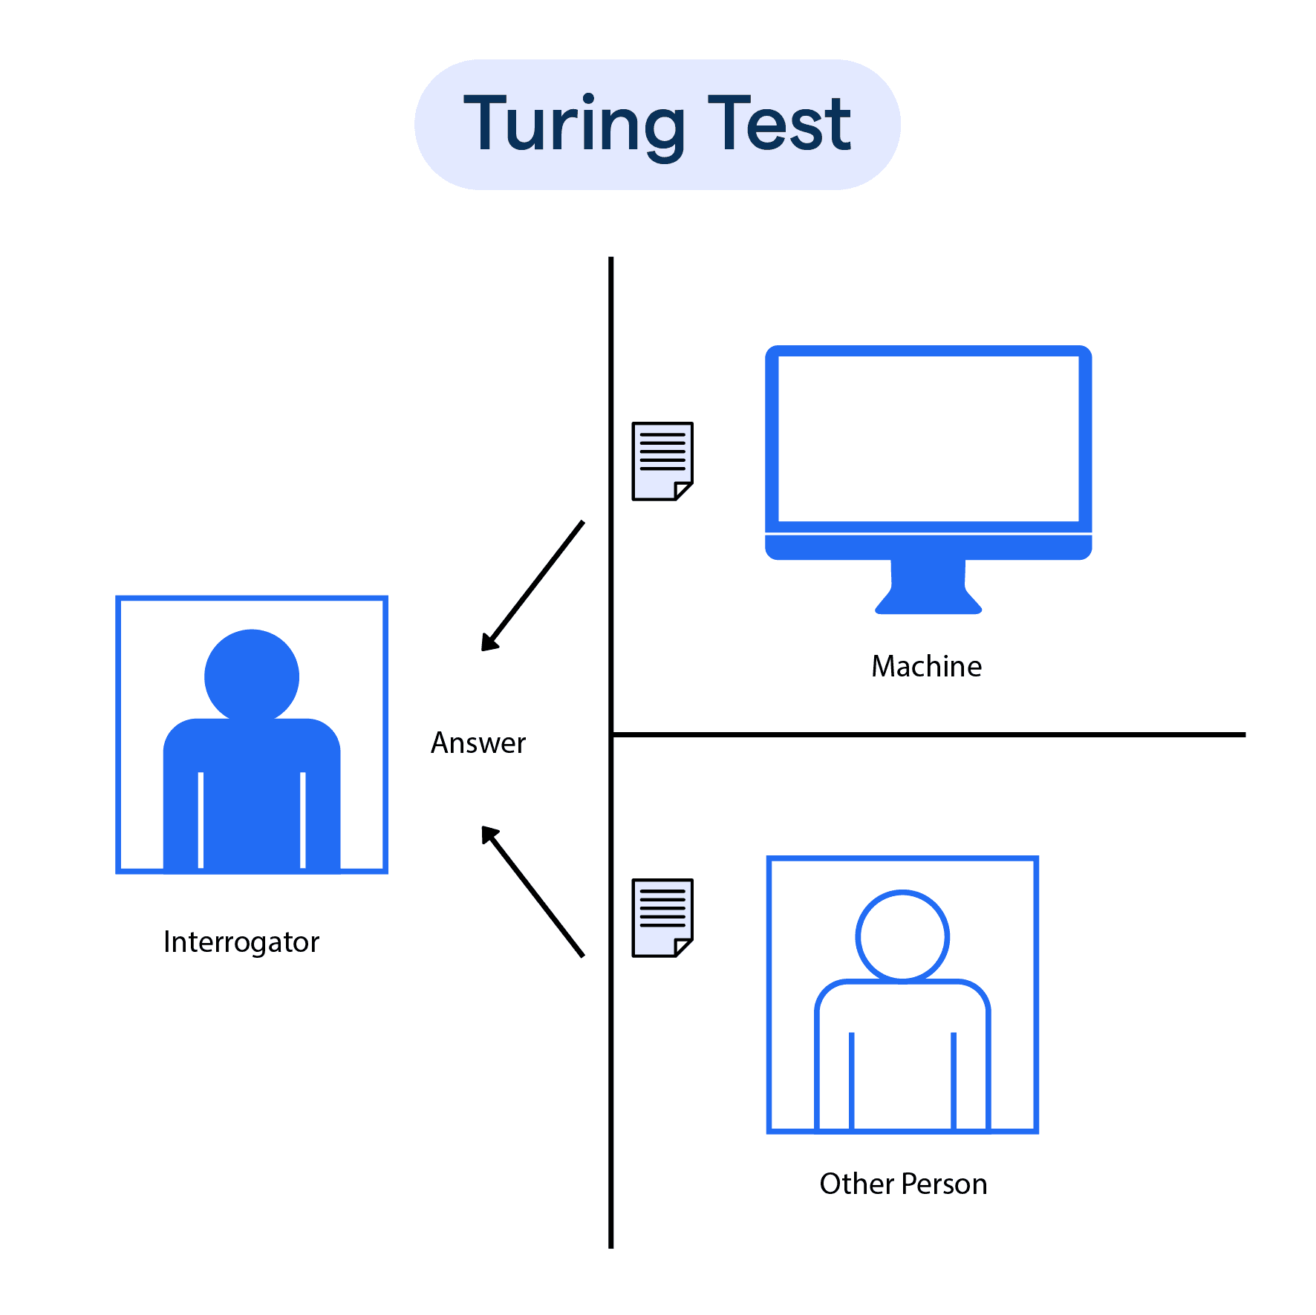
Can Machines Think?
Alan Turing's "imitation game" in 1950
If machines pass this test, they can "think"
Lots of issues with the validity of this...
Evidence of thinking ≠ thinking
What does it mean to "think"?
Does following direction (aka completing an algorithm) count as thinking?

Slide 7
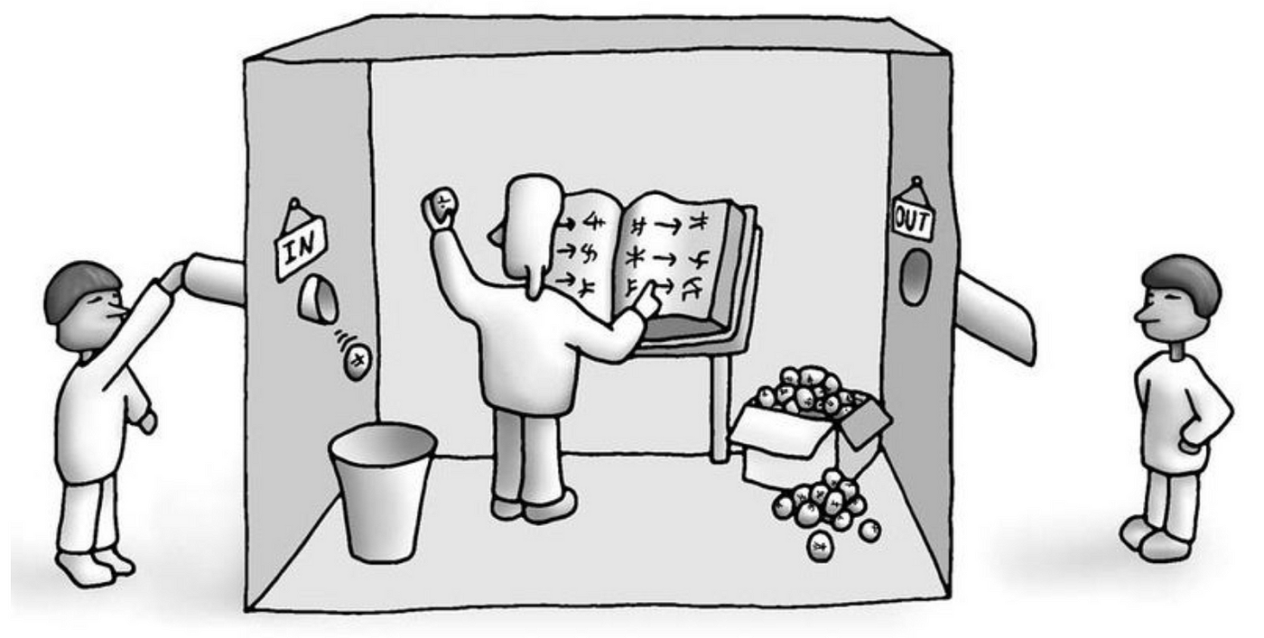
The Language Room Argument
Left: asks a question
Middle: has a rulebook
Right: gets an answer
You would think the person in the middle knows this language!
Does the room itself understand this language? – connection to computers
Need to comprehend semantics
Interpretation and symbolic meaning

Slide 8
Naturalism
Scientific naturalism emphasizes the importance of scientific methods and findings in understanding the world
"Philosophy should be continuous with science"
Foundationalism (philosophy of science should work from an external and secure standpoint)
We do not know yet whether scientific ideas are reliable thus we cannot assume they are reliable
Naturalism opposes foundationalism
Naturalism proposes we aim instead to develop an adequate description of how knowledge and science work if we draw on scientific ideas as we go

Slide 9
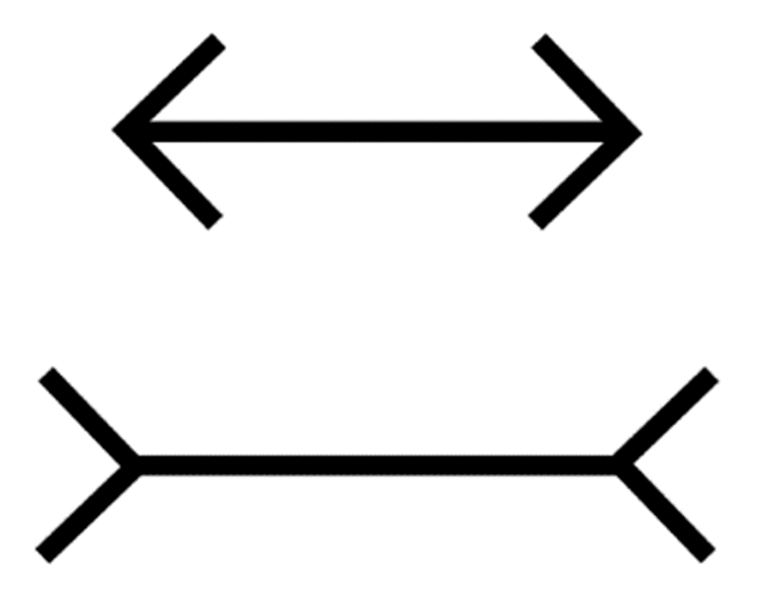
The Mueller-Llyer Illusion

Slide 10
Realism
Scientific realism emphasizes the importance of scientific theories and models in providing accurate descriptions of the world
Scientific realists aim to accurately represent the structure and workings of reality, even if our current understanding is incomplete
Two versions: Focus on the results of science or focus on the aims of science
Toward different branches of science and different aspects of theory, we should have different levels of confidence about the accuracy

Slide 11
Naturalism, Realism & Data Science
Naturalism
Emphasis on empirical observations
Commitment to scientific methods
Naturalistic assumptions (belief in reliability of data, pursuing natural explanations in analysis and rejecting supernatural/non-natural)
Realism
Objective reality in data interpretations (confidence in underlying patterns and relationships)
Ethical realism and ethics in data (ethical standards grounded in objective moral truths)
Objective truths about the world can only be known through reliable methods of analysis

Slide 12
Intro to Normative Ethics
Branch of philosophy concerned with establishing principles or norms to determine what actions are morally right or wrong
Questions how individuals ought to act
Several branches:
Consequentialism – Theories that evaluate the morality of actions based on their outcomes or consequences (Does the end justify the means?)
Psychological egoism – Theory that humans are self-interested and that all actions are motivated by self-interest (regardless of consciousness)
Ethical egoism – Theory that advocates for individuals to act in their own self-interest and prioritize their well-being (self-interest as a moral principle)
Moral nihilism – Theory that there is no morally right or wrong decision, however society puts pressure on us to make us think there is

Slide 13
Normative Ethics & Data Science
Ethical Data Collection: Normative ethics provides principles for ethically collecting data (consent, privacy, confidentiality)
Fairness and Bias: Normative ethics emphasizes principles of fairness and justice, which are crucial in addressing biases in data collection, analysis, and the decision-making processes (protecting certain groups)
Social Impact and Responsibility: Normative ethics encourages consideration of the broader social impact of data science projects and applications (how do findings impact the public good)

Slide 14
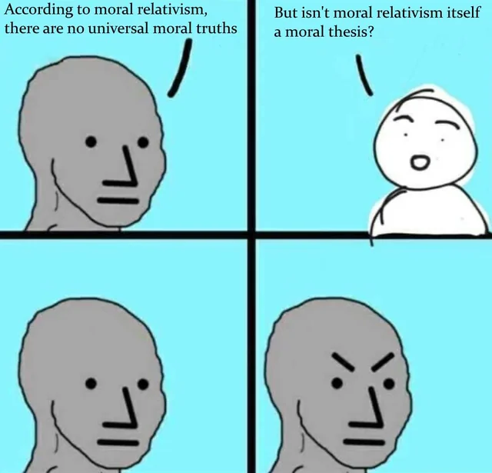
Who’s to say what’s right or wrong?
Ethical subjectivism :moral judgments are true if they accurately report an individual's feelings or commitments, making morality relative to personal views.—how one's subjective view can influence data interpretation and decision-making.
Cultural(Moral) relativism: moral standards are correct relative to cultural or societal norms.
When analyzing data or implementing data-driven policies, should we adhere to universal standards, or should we adapt to cultural specificities?

Slide 15
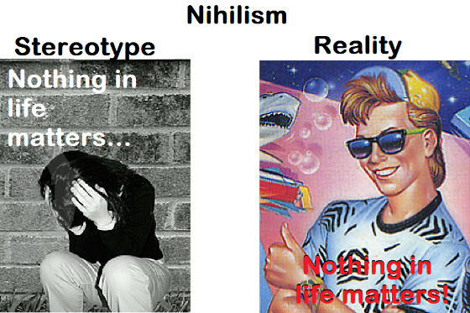
Is there such a thing as right and wrong?
Moral nihilism: moral facts do not exist;
Thus, no action is inherently moral or immoral
The absence of inherent moral values could lead to ethical problems in decision-making processes, where decisions are made based on personal preferences, rather than universal ethical standards.
Doesn’t morality require religion or a god?
Moral laws and principles can exist independently of religious beliefs, and individuals can find moral motivation and guidance through secular means.
In data science, this encourages us to find secular, rational foundations for ethical decision-making, beyond religious.

Slide 16
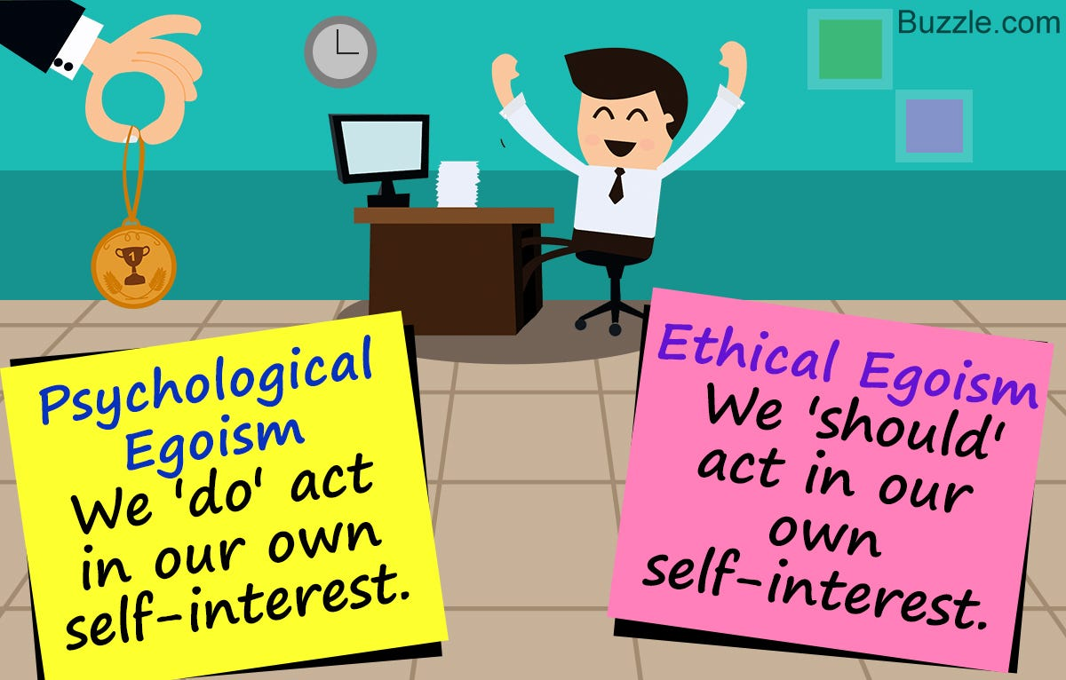
Aren’t we always motivated by self-interest?
Psychological egoism : all human actions are ultimately motivated by self-interest.
Should we be motivated by self-interest?
Ethical Egoism prescribes that individuals ought to act in their own self-interest.
Ethical egoism might undermine efforts in data science that are aimed at the public good or require collaboration and data sharing. For example, in a pandemic, withholding valuable data or models for personal or corporate gain could hinder public health efforts.

Slide 17
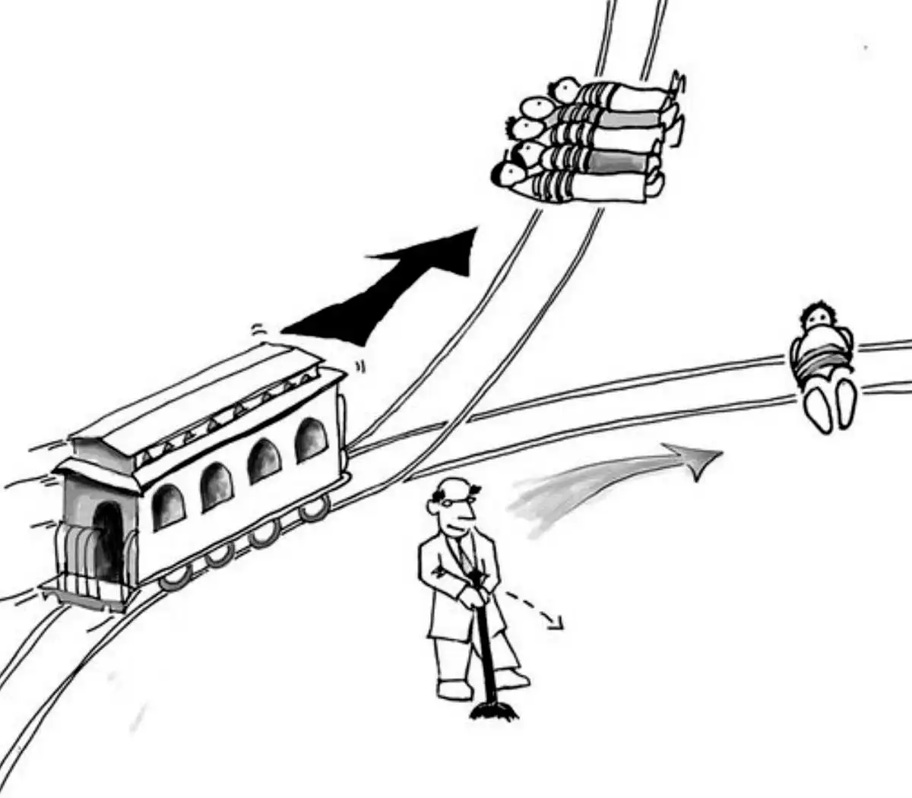
Shouldn’t we aim to maximize goodness in the world? Consequentialism: the morality of an action is determined by its consequences, whether it produces the best overall results or maximizes well-being. Data Privacy vs. Public Good: Data scientists might face situations where collecting and analyzing personal data could lead to significant public benefits but at the cost of individual privacy. Autonomous Vehicles: make split-second decisions in crash scenarios. Should our algorithm be programmed to minimize overall harm, even if it means sacrificing the vehicle's occupants?

Slide 18
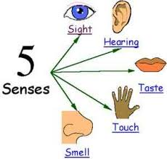
Is perceptual experience the only source of genuine knowledge?
Empiricism: knowledge comes primarily from sensory experience
Logical Positivism: a statement is only meaningful if it can be empirically verified. In data science, a model or hypothesis gains credibility only when it can be verified with data.

Slide 19

“What if everyone did that?” Shouldn’t fairness guide our actions? Shouldn’t we refrain from treating humans as mere things?
Universalizability principle
treating humans as ends in themselves, rather than as mere means
User Privacy and Consent: Respecting individuals' autonomy by ensuring that data is collected and used with informed consent. Data should not be exploited merely for benefit without considering individuals' rights.

Slide 20

Should we focus on falsifiability, rather than confirmability?
Falsificationism: for a theory to be considered scientific,
it must be testable and falsifiable.
Consider the theory that "All swans are white." This statement is falsifiable because it can be tested by observation.
If someone finds a single black swan, the theory is falsified.

Slide 21
Resources
Why use philosophy in data analytics?: https://medium.com/@kurt.r.peters/the-philosophy-of-data-science-4fa9e0715531
YouTube series: https://www.podofasclepius.com/philosophy-of-data-science

Slide 22
Thank You!

